Slide 1
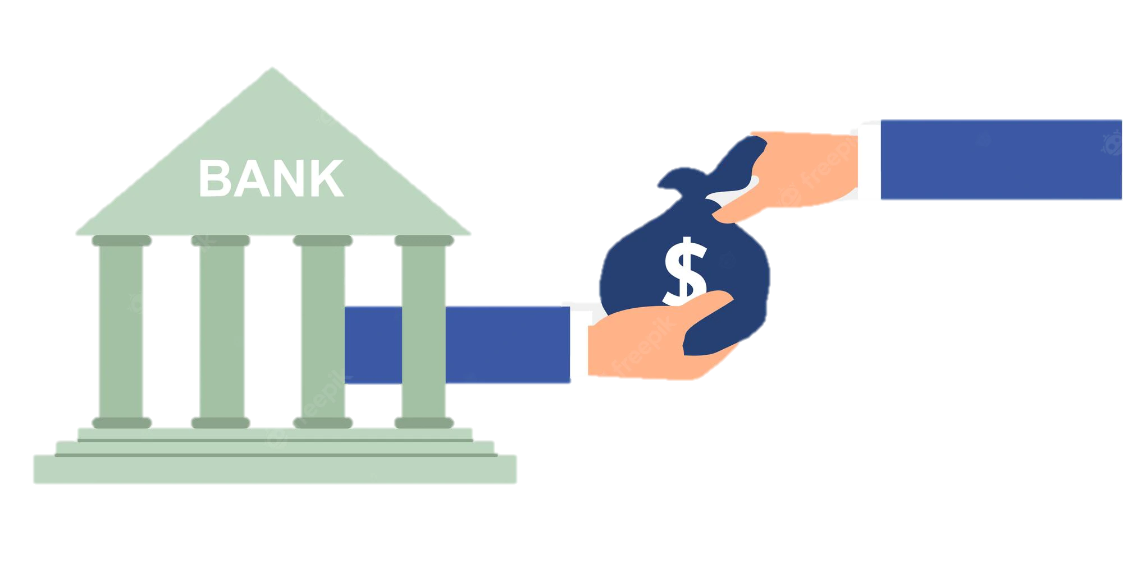
Loan Prediction Based on Customer Behaviour
Joshua Vincentius

Slide 2
Background
Bank wants to predict who possible defaulters are for the consumer loans product
Bank wants to implement better process at acquiring new customers by predicting which customers are risky and which are not

Slide 3
Objectives
Analysis on customer behaviour
Predict which customers are riskier and which are not risky
Simulate benefits of implementing machine learning model to predict risky customers

Slide 4
Table of contents
01
Data Profiling and Preprocessing
02
Exploratory Data Analysis
03
Feature Engineering
04
Modelling and Evaluation
05
Business Simulation
06
Conclusions and Recommendations

Slide 5
01
Data Profiling and Preprocessing

Slide 6
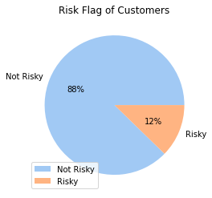
Data Profiling
Training dataset has 252,000 rows and 13 columns with ‘Risk Flag’ as its target variable (0 is not risky and 1 is risky)
Numerical columns: ID, Income, Age, Experience, Current job in years, Current house in years
Categorical columns: Marital status, House ownership, Car ownership, Profession, City, State
Imbalanced data on its target variable

Slide 7
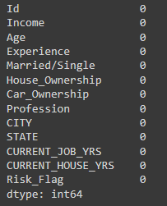
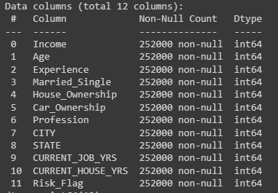

Data Preprocessing
Duplicates
Missing Values
Dropping Columns
There is no missing values in the dataset
There is no duplicates in the dataset
Dropping unnecessary columns ‘ID’

Slide 8
02
Exploratory Data Analysis

Slide 9
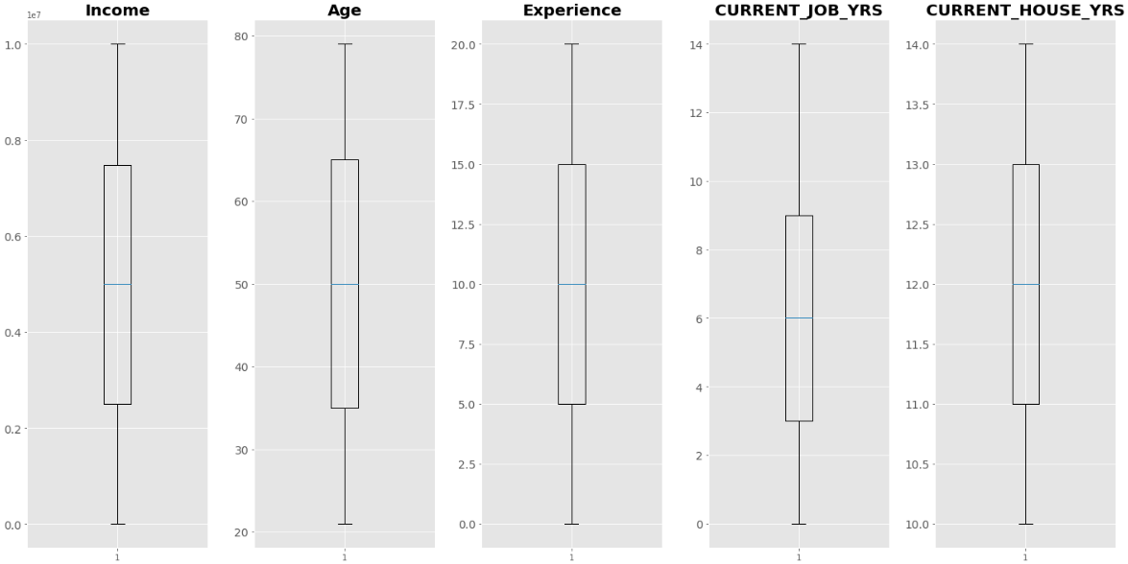
Boxplot to Detect Outliers
There is no outliers detected in the dataset. Therefore, it is safe to proceed to the next step

Slide 10
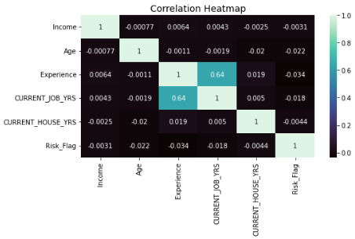
Correlation Heatmap
There is no multicollinearity that shows strong correlation between the column features with the assumption that strong correlation is above 0.8

Slide 11
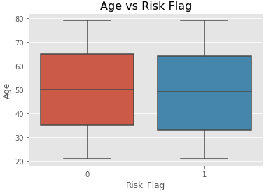
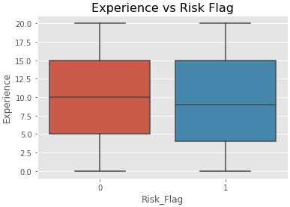
Age Is Just A Number
Age of customers doesn’t seem to affect the overall risk flag score significantly and can be neglected in customer behaviour analysis. On the other side, the customers that defaulted at bank loan seems to have lower experience than those who didn’t default

Slide 12
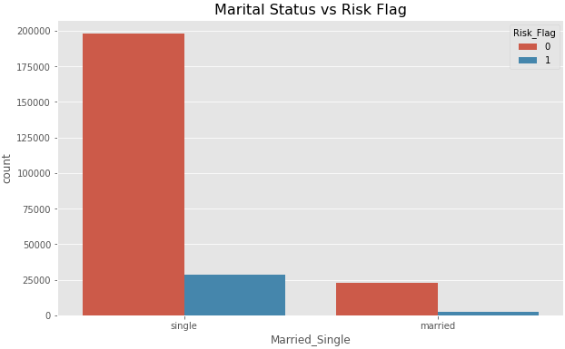
Single Customers Are Risky
Marital Status | Total Percentage(%)
Single | 12.53%
Married | 10.24%
Average | 12.3%
Mostly the customers who take the bank loan is single / not married.
The percentage of single customers who defaulted is also higher than the percentage of total customers who defaulted

Slide 13
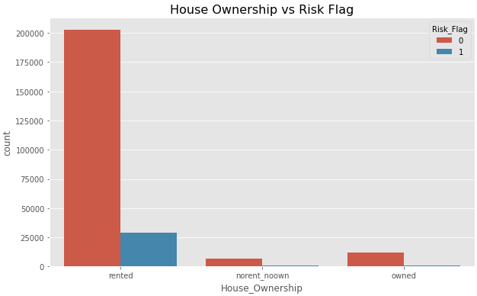
Customers Need to Pay for Their House Rental
House Ownership | Total Percentage(%)
Rented | 12.55%
Not Rented Not Owned | 9.95%
Owned | 8.97%
Average | 12.3%
Mostly the customers who take the bank loan is taking house rental
The percentage of customers who rented house and defaulted is also higher than the others

Slide 14
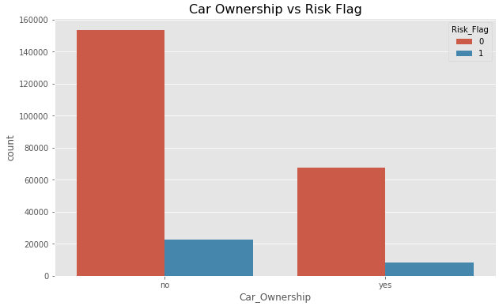
No Car, Yes Loan
House Ownership | Total Percentage(%)
No | 12.81%
Yes | 11.09%
Average | 12.3%
Mostly the customers who take the bank loan don’t own a car
The percentage of customers who don’t own a car and defaulted is also higher than the others

Slide 15
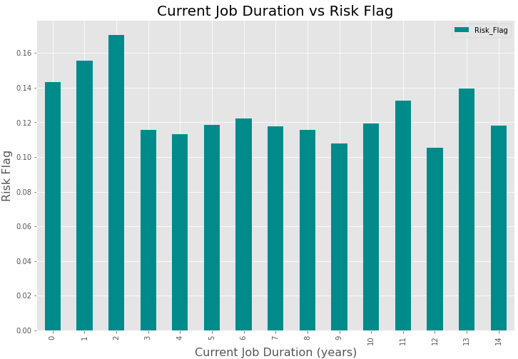
The First 2 Years In Job Is Critical
Customers with current job duration ranging from 0 to 2 years tend to have higher percentage of risk flag than the rest. The risk flag percentage tends to flatten once they have passed the first 2 years in their job

Slide 16
03
Feature Engineering

Slide 17

Feature Engineering
Label Encoder
Feature columns: Marital status, House Ownership, Car Ownership, Profession, City, State
Imbalanced Data
Undersampling method using RandomUnderSampler

Slide 18
04
Modelling and Evaluation

Slide 19
Modelling and Evaluation
Train – test data proportion: 80% - 20%
Model Name | Accuracy | Precision | Recall | F1 -Score | ROC AUC Score
K-Nearest Neighbor | 88.7% | 55.4% | 49.6% | 52.3% | 87%
Decision Tree | 87.9% | 51% | 81% | 62.6% | 85%
Random Forest | 89.6% | 56.2% | 76% | 64.6% | 94%
XGBoost | 88.5% | 66.8% | 16.5% | 26.5% | 88%
Random Forest Undersampling | 84.9% | 86.9% | 81.7% | 84.2% | 94%

Slide 20
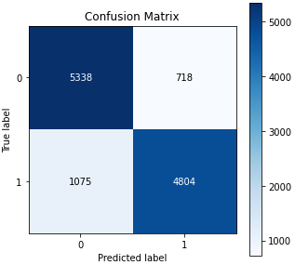
Confusion Matrix
The matrix above shows that from 5622 customers on predicted label 1 (defaulted customers), our model can predict 4804 of them correctly which is approximately 85.4%

Slide 21
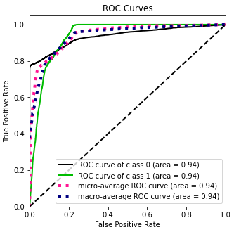
ROC Curve
The curve above shows that our model accuracy to predict the customers that will default if given bank loan is about 94%

Slide 22
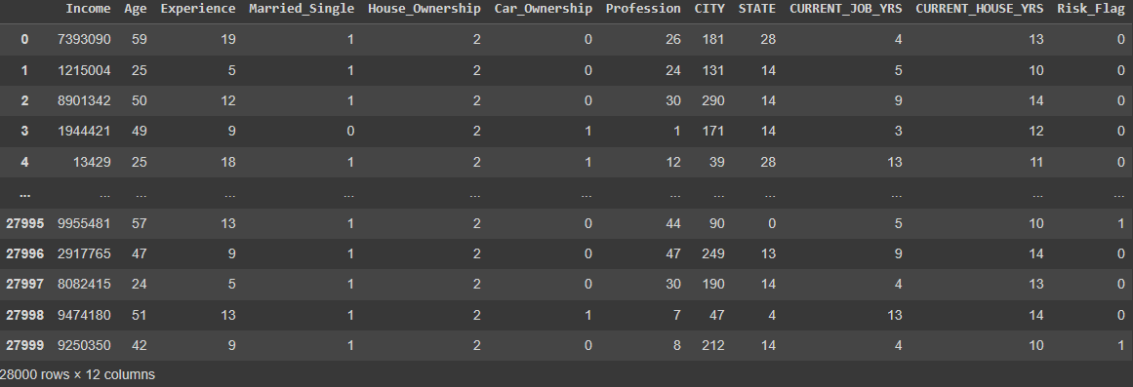
Prediction Result
Test dataset has 28,000 rows and 12 columns
Unnecessary column ‘ID’ is dropped
The chosen model predict the risk flag of the customers in the test dataset

Slide 23
05
Business Simulation

Slide 24
Business Assumption
Each customer has an average loan of 100,000 USD
The average interest rate for each loan is approximately 10%
The interest rate isn’t calculated for customers who defaulted
For calculation using machine learning model, the cost is negligible with the assumption bank loan will not be given to the predicted customers that will default
Cost calculation is only calculated from the defaulted customers and revenue calculation is only calculated from the interest rate

Slide 25
ROA With vs Without Model
1.25%
-3.5%
With Model
Without Model

Slide 26
06
Conclusion and Recommendation

Slide 27
Recommendation
Conclusion
Factors that affect the risk flag the most are experience (job), rented house ownership, no car ownership and single marital status respectively
Best model: Random Forest Undersampling with 84.2% F1-Score and 94% ROC score
Machine learning model implementation does improve the overall business of the bank by increasing the ROA from -3.5% to 1.25% (with business assumption)
Bank can develop customers loan products for all ages without concern
Bank can implement stricter loan terms and conditions for customers that are single, has low years of experience (job), do not own car and currently taking a house rental to reduce loan risk potential

Slide 28
Thanks!
Do you have any questions?
joshuavincentius98@gmail.com
+62 81 1604 3817

